Slide 1
SCLA
* For Study only

Slide 2
Business Objective & Data Information
Business Objective
Predict the shipping mode for the parcels
Data Understanding
File Name: Inventory
Time Period: 2007 to 2010

Slide 3
More Information on data
Data Dimension
Observation: 7853 and Variables: 8
Name of Variables
Order Date, Order ID, Order Quantity, Product Container, Product Name, Product Sub-Category, Sales, Ship Mode
Air Express, Regular Express and Delivery Truck
Type of variable
Date: 1, Factor: 4,Int: 2 and Unique Key: Order ID
Shipping Mode
There are not missing values and Outlier in data
Missing Values and Outliers

Slide 4
Exploratory data analysis
Distribution for continuous variables
From the above distribution, it is clear that there are no outliers and missing values.
Correlation between order quantity and sales is 0.22
50% of sales and 75% of order quantity is coming from regular air mode

Slide 5
Product Category Views

Slide 6
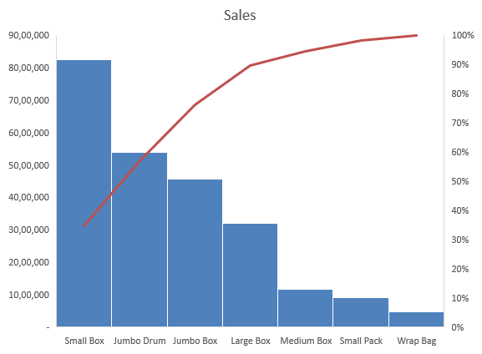
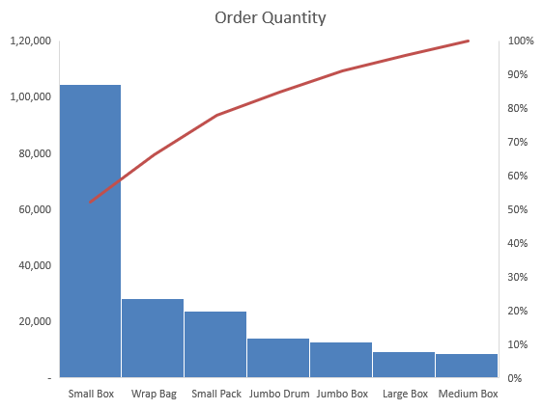
Product Category Views
Top 3 contributor for sales are small box, Jumbo Drum and Jumbo Box
Top 3 contributor for order quantity are small box, Wrap bag and Small pack

Slide 7
Sub Product Category Views

Slide 8
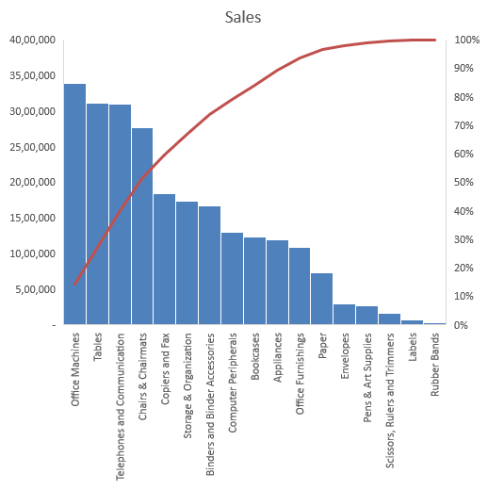
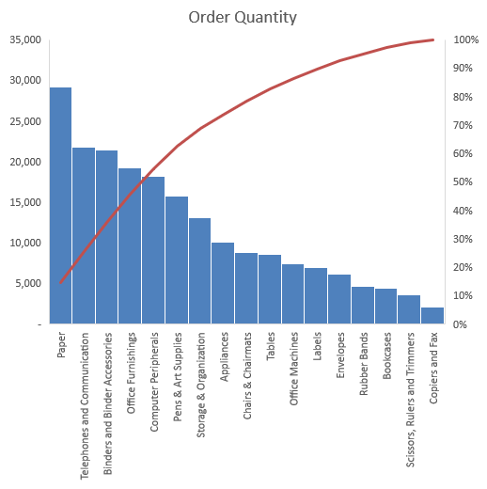
Sub Product Category Views
Top 3 contributor for sales are Office Machines, Tables and Telephones and Communication
Top 3 contributor for order quantity are Paper, Telephones and Communication and Binders and Binder Accessories

Slide 9
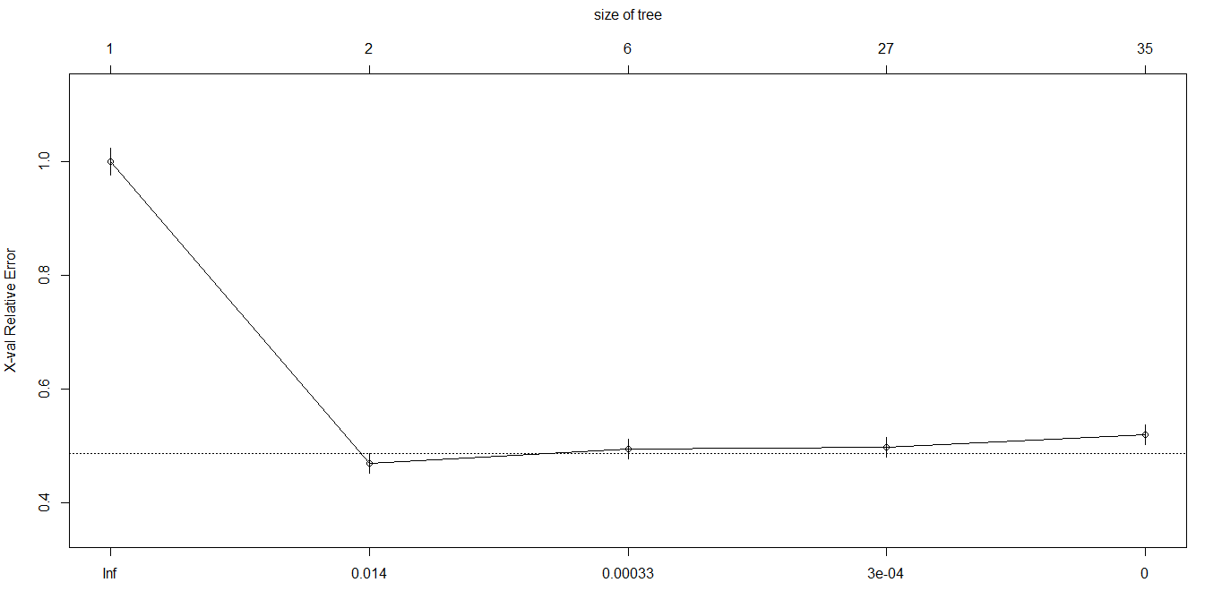
Modelling
Independent Variables: Order Quantity, Product Container, Product Sub-Category and Sales
Dependent Variable: Ship Mode
Splitting the population into train and test (70:30). Train size is 5497 and test size is 2356.
Running CART on train with all the independent variables and checking for pruning. After one split cp goes drastically down (ref below image) and the remain same for further split. Hence pruning the tree till one split only.
After getting the pruned tree, model has been validated on the test dataset. And performance has been measured

Slide 10
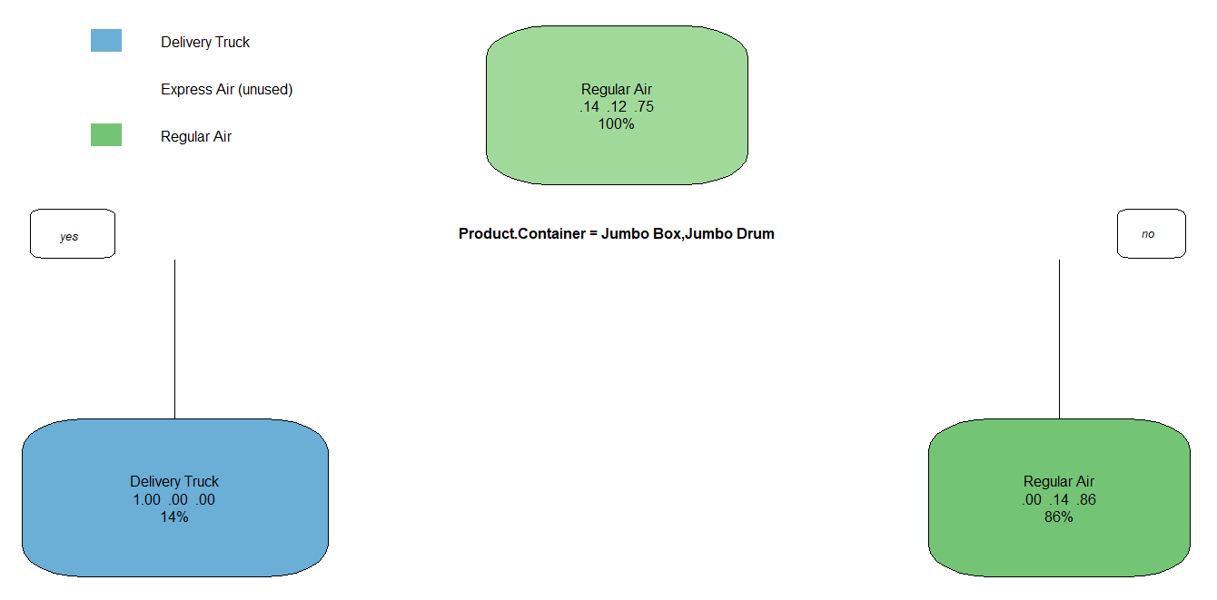
Model Interpretation
If product category is Jumbo box or Jumbo drum, supervisor is always go for Delivery truck. And if product category is other than Jumbo box and Jumbo drum supervisor goes for Regular air. Supervisor will never use express Air mode of shipping.

Slide 11
Performance
Train
Test
 |  | Predicted
 |  | Delivery Truck | Express Air | Regular Air | Total
Actual | Delivery Truck | 743 | - | - | 743
 | Express Air | - | - | 657 | 657
 | Regular Air | - | - | 4,097 | 4,097
 | Total | 743 | - | 4,754 | 5,497
 |  | Predicted
 |  | Delivery Truck | Express Air | Regular Air | Total
Actual | Delivery Truck | 320 | - | - | -
 | Express Air | - | - | 264 | 264
 | Regular Air | - | - | 1,772 | 1,772
 | Total | 320 | - | 2,036 | 2,356
Accuracy Rate: 88.05
Error Rate: 11.95
Accuracy Rate: 88.79
Error Rate: 11.21
Model performance is consistent in train and test dataset, Hence model is good to go for deployment.

